Slide 1
Change Assurance Update
DSC Change Committee June 2018

Slide 2
Content
Background
The Framework
Change Assurance Plan
Interactions with DSC Change Committee
Questions

Slide 3
Background
Following the completion of Nexus customer feedback suggested that Xoserve should have the capability to carry out assurance of its project and programmes. This capability should be:
Independent
Resourced by Xoserve and able to assure the majority of the portfolio
Able to, when appropriate, commission cost effective assurance work from 3rd Parties
We tested this view at the Customer Day and had the principles above validated
You also gave us further principles to apply as we set up the function

Slide 4
Background

Slide 5
Background
Xoserve engaged Baringa to work with us to define a change assurance framework. This work did not include delivering the capability
We have been working to establish the capability, processes, reporting etc. This work has been done in parallel with starting to carry out change assurance assessments.

Slide 6
Change Assurance Framework - Categorisation
Driver | % | Category 1 | Category 2 | Category 3 | Category 4 | Category 5
Customer (B2B) | 20% | No customers likely to be materially impacted | One customer type may experience minor impacts | One customer type may experience major impacts | Multiple customer types may experience minor impacts | Multiple customer types may experience major impacts
Consumer | 10% | no consumers likely to be materially impacted | Potential for minor impact (guidance ~0 to 10% AQ) | Potential for moderate impact (~10% to 33%) | Potential for major impact (~33% to 80%) | Potential for most consumers to be impacted (~≥80%)
Regulatory / Political¹ | 15% | Either no non compliance concern or minimal potential exposure. No material risk of market intervention. | Potential non compliance concern with small potential exposure. No material risk of market intervention by regulator | Potential non compliance concern with medium potential exposure. Low risk of material market intervention by regulator | Potential non compliance concern with large potential exposure. Medium risk of material market intervention by regulator | Potential non compliance concern with very large potential exposure. High risk of material market intervention by regulator
Reputation | 15% | Minimal risk of adverse coverage in national news (either for Xoserve and /or STKG specifically in industry coverage, or for the industry generally in non-industry news) | Low risk of adverse coverage in national news (either for Xoserve and/or STKG specifically in industry coverage, or for the industry generally in non-industry news) | Medium risk of adverse coverage in national news (either for Xoserve and/or STKG specifically in industry coverage, or for the industry generally in non-industry news) | Significant risk of adverse coverage in national industry news for Xoserve and/or STKG (specifically) and/or significant risk of adverse coverage for industry generally in national news | Significant risk of adverse coverage in national (general) news for Xoserve and/or STKG (specifically)
Financial | 15% | <£0.5m | ≥£0.5m and <£2.0m | ≥£2.0m and <£5.0m | ≥£5.0m and <£10.0m | ≥£10.0m
Delivery Complexity² | 15% | Guideline: PAT average score <1.5 | Guideline: PAT average score ≥1.5 and <2.0 | Guideline: PAT average score ≥2.0 and <2.5 | Guideline: PAT average score ≥2.5 and <3.0 | Guideline: PAT average score ≥3.0
People and Process | 10% | <5% of workforce impacted; minimal potential impact on Xoserve processes | ≥5% and <10% of workforce impacted; low potential impact on Xoserve processes | ≥10% and <30% of workforce impacted; medium potential impact on Xoserve processes | ≥30% and <50% of workforce impacted; large potential impact on Xoserve processes | ≥50% of workforce impacted; very large potential impact on Xoserve processes
Total | 100% | <1.5 overall | ≥1.5 and <2.0 overall | ≥2.0 and <2.5 overall | ≥2.5 and <3.5 overall | ≥3.5 overall
Customer centric
Regulatory and Reputation
Scale and Scope
STKG – Stakeholder Group
PAT – Project assessment Tool

Slide 7
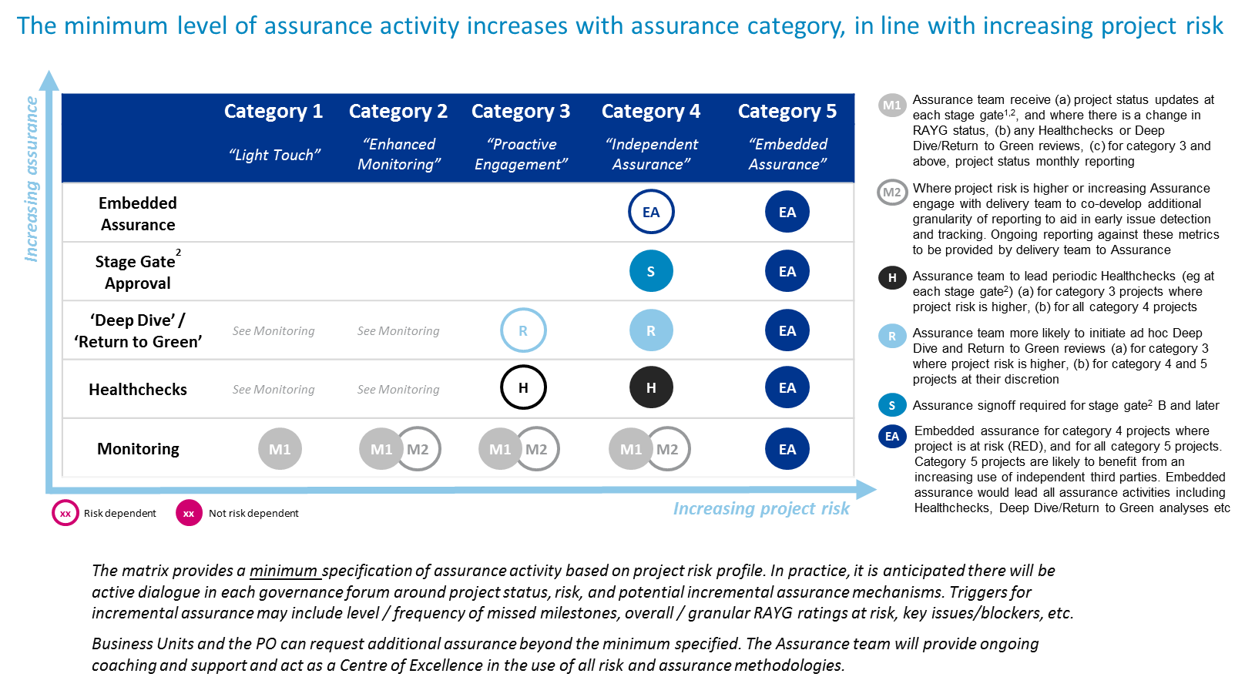
Change Assurance Framework – Levels of Assurance

Slide 8
Change Assurance Framework - Example
UK Link Release 3
Category 4 driven by complex program with potential B2B impacts across multiple customer types

Slide 9
Change Assurance Portfolio Category View - May 2018

Slide 10
Change Assurance Plan
R2 Stage Gate
R2 Health
check
R3 Health
check
R3 Health
check
TU Lessons
Learnt
TU ERP
Stage Gate
TU N&D
Health Check
TU N&D
Stage gate
GB C
Health Check
D E P
Health Check

Slide 11
DSC Change Committee Interactions - Proposed approach
Monthly provision of:
Change assurance Plan on a page (POAP) included with UK Link and Gemini POAPs
Dashboard of Change Assurance Assessment Results
Quarterly attendance by the Head of Change Assurance at DSC Change Committee (when there are no Amber or Red assurance results to report)
If there are Amber or Red results to communicate, the Head of Change Assurance will attend DSC Change Committee
DSC Change Committee can request the attendance of the Head of Change Assurance on an ad hoc basis

Slide 12
UK Link Release 2 health-check outcome
Health-check Scope | RAYG
Testing and readiness for Implementation |  | Overall status is yellow indicating that the project is in reasonable health with minor issues that could represent a low risk to the project’s overall success. Project is well run with clear business case, plan and reporting. The team is aligned and the project is on track for go- live. The stakeholders interviewed generally expressed confidence in the testing and in the state of readiness for implementation. There were 6 summary points identified relating to: scope documentation testing approach business change business implementation planning multi-release documentation approach and general documentation
Health-check category | RAYG | Health-check category | RAYG
Business Case |  | Planning
Sponsorship |  | Customer
Governance |  | Testing
Scope & Solution |  | Implementation
Team & Skills

Slide 13
Questions?

