Slide 1
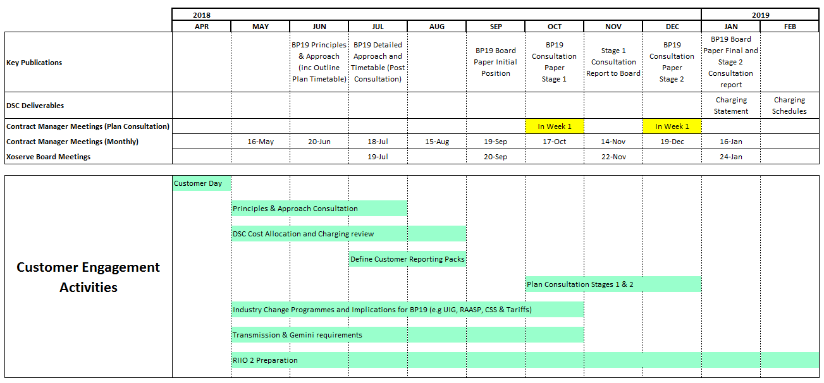
Draft BP19 Customer engagement timetable
What do you think is the appropriate length for a Customer consultation process?
Are there any important Customer deadlines we need to be aware of?

