Slide 1
January
MIS Development – DSC Change Management Committee update
9th May 2018

Slide 2
MIS VISION
January
Vision Statement (sign off 1st May):
“The Market Intelligence Service (MIS) provides timely energy markets data (accurately represented), processes and services to deliver greater efficiencies, improved practices, and a better and more reliable consumer experience.”

Slide 3
MARKET ENGAGEMENT
January
Open Letter published 4th January
The Open Letter was the first stage of an ongoing consultation approach
Bilateral discussions
Over 20 responses: range of stakeholders: suppliers, networks, metering organisations, water/business customer, Citizens Advice, medium/large suppliers, as well as from Alt Han Co.
Wide spread support
Broad consensus for an unconstrained approach
Initial priorities focusing on extending the API service to energy suppliers and support for Ofgem’s Faster and More Reliable Switching Programme (switching programme)
A number commented it was right to fund the MIS development via the MRA and UNC governance mechanisms; some respondents also commented other more flexible funding arrangements
Central to many responses was the need to undertake a cost/benefit assessment to ensure value for money as progress is made with the Use Cases
Over 55 Use Cases identified, more Use Cases are evolving
April JMDG reviewed all Use Cases and prioritised for impact assessment

Slide 4
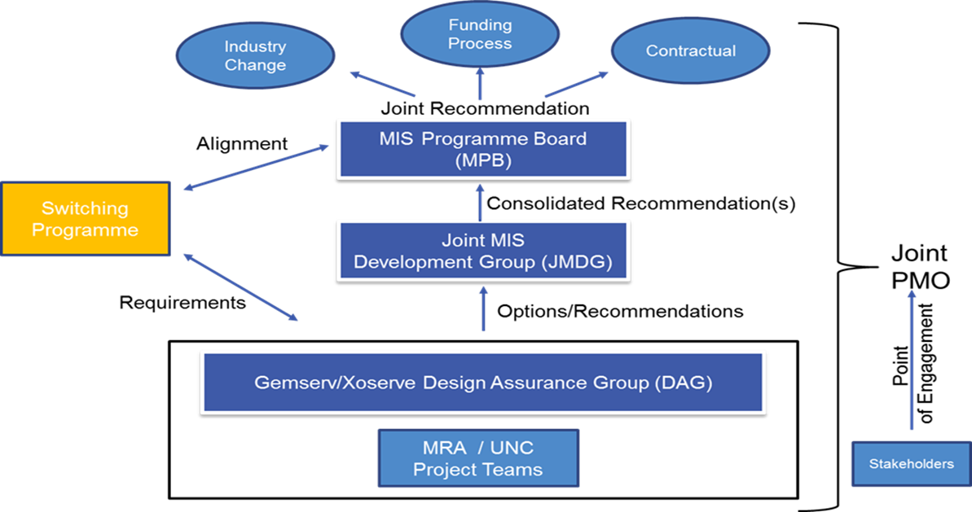
MIS GOVERNANCE FRAMEWORK
January

Slide 5
ROADMAP – May 2018
January
2018
MIS Development Process
Analysis of Open Letter Response
MIS Vision Defined
MIS Development Principles Defined
Development of Use Case Definitions
Use Case Development Lifecycle
Xoserve / Gemserv Programme Team
Industry Open Letter
New Customer
Use Case
Q1
JMDG
Use Case Refinement
Prioritisation / Use Case Alteration
Use Case Prioritisation
JMDG Use Case Definition Refinement
MIS Release 2 Planning
MIS Platform Definition
Programme Management Board
Q2
Release Planning
Release Delivery

Slide 6
PRINCIPLES
January
Prioritisation Principles
Development Principles
Development of any Use Case must have the support of industry governance (i.e. JMDG/MPB)
Where it complements Ofgem’s faster and more reliable switching programme, it will be given a higher priority
A Use Case should have due regard to the overall MIS development and deployment, i.e. overall delivery should be efficiently optimised
Cognisant of wider industry change and the need for innovation
Cost vs benefit must be prepared
Requirements clearly defined and with a clear brief
Information and cyber security must be maintained, proportionate and robust and factored into each Use Case that is progressed
Commercial confidentiality must be respected
Supports dual fuel and single fuels
Not limited by the data held by ECOES and DES
MIS data should accurately represent its data source and be subject to a data quality assurance regime
Accessible to a appropriate range of actors (subject to Use Case)
Technical solution must be fit for purpose with respect to the Use Case aligning to simplification of industry
All Use Cases must factor in the risks and benefits for consumers

