Slide 1
UIG Resolution
Weekly Progress Update 11 May 2018

Slide 2
DM read rejection update
Pot 1 Key messages
Outstanding last week = 2
Closed this week = 0
0 meter points still impacting UIG (estimated consumption not accurate)
Row Labels | DMSP | N/A | SHIPPER | MAM | XOS | Grand Total
Assigned | 0 | 0 | 0 | 0 | 0 | 0
Closed | 0 | 175 | 0 | 0 | 0 | 175
Fix in Progress | 1 | 0 | 1 | 0 | 0 | 2
New | 0 | 0 | 0 | 0 | 0 | 0
Monitor | 0 | 0 | 0 | 0 | 0 | 0
Failed | 0 | 0 | 0 | 0 | 0 | 0
Total | 1 | 175 | 1 | 0 | 0 | 177
Total number of meter point queries open |  |  |  |  |  | 2
Pot 2 Key messages
Outstanding last week = 39
New Rejections identified = 5
Closed this week = 5
26 meter points still impacting UIG (estimated consumption not accurate)
Row Labels | DMSP | N/A | SHIPPER | MAM | XOS | Grand Total
Assigned | 16 | 0 | 3 | 5 | 3 | 27
Closed | 0 | 174 | 0 | 0 | 0 | 174
Fix in Progress | 2 | 0 | 1 | 0 | 2 | 5
Fixed | 0 | 0 | 1 | 0 | 0 | 1
New | 0 | 0 | 0 | 0 | 6 | 6
Monitor | 0 | 0 | 0 | 0 | 0 | 0
Total | 18 | 174 | 5 | 5 | 11 | 213
Total number of meter point queries open |  |  |  |  |  | 34

Slide 3
DM Financial Adjustments Progress
Root Cause Fixed:
175 (0)
CA Needed:
76 (-1)
New/Valid Contact Submitted:
54 (-1)
Shipper Notification Received:
22 (0)
CA Decision Pending:
8 (0)
No CA Required/ Closed:
91 (+1)
No Contact:
17 (0)
Invalid Contact:
5 (0)
Invoiced:
26 (0)
In Progress:
17 (-11)
Awaiting Billing:
11 (+10)
Not Required:
5 (0)
Complete:
21 (0)
Under Review:
15 (-12)
Issue With Adj:
2 (+1)
To Be Billed:
10 (+10)
Held Pending Rec:
1 (0)
POT 1: 177 (0)
Root Cause Pending:
2 (0)
Kwh:
29,737,699
(0)
Kwh:
31,537,376
(31,537,376)
Accurate as of 09.05.2018
Exposure: Retrospective CA not yet invoiced = 60 (-1)
[Root Cause Pending] + [CA Decision Pending] + [CA Needed] – [Invoiced]

Slide 4
Invoiced Figures (CA Only)
Deemed Not valid:
5 (0)
Invoiced: 26 (0)
Complete:
21 (0)
Jan-18:
1
Kwh: 0
GRE (£): 0.00
Feb-18:
4
Kwh: 128,335,231
GRE (£): 1,788,429.70
Kwh: -16,546,613
GRE (£): -145,611.57
Mar-18:
6
Apr-18:
10
Kwh: -82,050,919
GRE (£):
-1,301,925.35
May-18:
Pending
Kwh: tbc
GRE (£): tbc
Kwh value represents the primary debit/(credit) equal and opposite value feeds UIG Reconciliation
Accurate as of 09.05.2018

Slide 5
Exposure MPRNs - AQ & Class
Exposure: Retrospective CA not yet invoiced = 67 (0)
[Root Cause Pending] + [CA Decision Pending] + [CA Needed] – [Invoiced]
HISTORIC
CLASS | AQ ROLL (Kwh) | MPRN
1 | 14,534,819,022 | 67
2 | 0 | 0
3 | 0 | 0
4 | 0 | 0
 | 14,534,819,022 | 67
CURRENT
CLASS | AQ ROLL (Kwh) | MPRN
1 | 9,790,576,406 | 40
2 | 333,423,941 | 21
3 | 0 | 0
4 | 177,418,161 | 6
 | 10,301,418,508 | 67
Details of outstanding MPRNs when the issue was originally reported to investigate and attempt resolution
Details of exposure MPRNs as of today
Please Note: The above details are for guidance only, any potential CA’s submitted may span multiple AQ changes during the period of adjustment
Accurate as of 25.04.2018

Slide 6
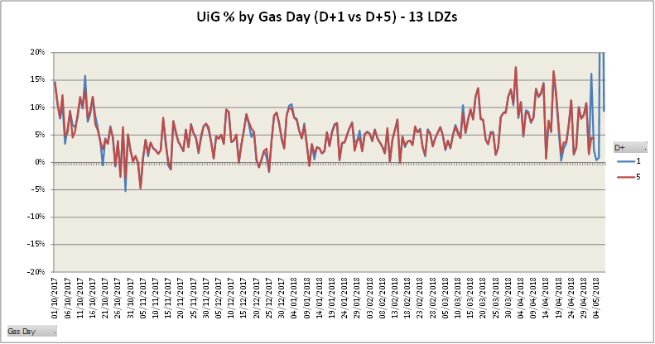
Latest UIG volatility
Key Comments:
Gas Day 2nd May 2018 - The majority of DM Measurements for this gas day were not present in the Gemini system, in time for the first run of Allocation. This resulted in erroneously high Unidentified Gas values across all LDZs. This issue was investigated and resolved in time for the second run of Allocation.
Gas Day 6th May 2018 – NDM Allocation failed to calculate for this gas day on the first run of Allocation, affecting all LDZs. This resulted in erroneously high Unidentified Gas values (c70%) across all LDZs. This issue was investigated and resolved in time for the second run of Allocation.

