Slide 1
Information to support discussion at Distribution Workgroup - UNCVR - Gazprom Proposal

Slide 2
Background - Tolerance Rules
Validation Rules set out in 2 tolerance ranges
Inner Tolerance Range (ITR) that the Shipper User can override
Outer Tolerance Range (OTR) that the Shipper User cannot override.
Class 1 / 2 based on SOQ; Class 3 / 4 based on AQ.
Class 3 / 4 is AQ/365*range
Different AQ Bands have different ITR / OTR range….
Example:
Lower AQ Band (kWh) | Upper AQ Band (kWh) | Tolerances where read will be accepted | Tolerances where a Read will be Accepted if Submitted within Override Flag (Inner Tolerance) | Outer Tolerance Where Read will be Rejected (Market Breaker)
1 | 1 | 0% - 2,000,000% of AQ/365 x no. of days | 2,000,001% - 7,000,000 % of AQ/365 x no. of days | >= 7,000,001% of AQ/365 x no. of days
2 | 200 | 0% - 10,000% of AQ/365 x no. of days | 10,001% - 25,000 % of AQ/365 x no. of days | >= 25,001% of AQ/365 x no. of days
201 | 500 | 0% - 4,000% of AQ/365 x no. of days | 4,001% - 10,000 % of AQ/365 x no. of days | >= 10,001% of AQ/365 x no. of days

Slide 3
Background - Tolerance Rules
Tolerance Ranges were set based on limited information, but agreed with the industry
As required by the industry, these were provisioned so that this could be changed when better information became available
Prior to implementation the industry sought to reassess via PNUNC / DWG – but insufficient information to pursue this
Post PNID a Change Proposal has been received and scheduled to split the 2-200 kWh band – this is in November 2018 UK Link Release
Lower AQ Band (kWh) | Upper AQ Band (kWh) | Tolerances where read will be accepted | Tolerances where a Read will be Accepted if Submitted within Override Flag (Inner Tolerance) | Outer Tolerance Where Read will be Rejected (Market Breaker)
1 | 1 | 0% - 2,000,000% of AQ/365 x no. of days | 2,000,001% - 7,000,000 % of AQ/365 x no. of days | >= 7,000,001% of AQ/365 x no. of days
2 | 100 | 0% - 20,000% of AQ/365 x no. of days | 20,001% - 45,000 % of AQ/365 x no. of days | >= 45,001% of AQ/365 x no. of days
101 | 200 | 0% - 10,000% of AQ/365 x no. of days | 10,001% - 25,000% of AQ/365 x no. of days | >= 25,001% of AQ/365 x no. of days

Slide 4
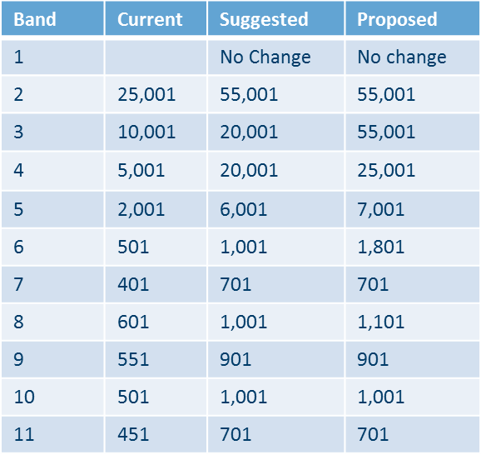
Gazprom’s Proposal
Red arrows indicate current Change Proposal

Slide 5
Requirement Statements
Reduce instances of Meter Reading Tolerance Failures – i.e. where Shipper is unable to override this failure
Retain existing value of Shipper User ITR, this is to:
Retain Shipper responsibility to validate and override as necessary
Remove this being a mandated Shipper change (and avoid Shipper User deferral to Major Release)
Utilisation of existing parameters for change in order to realise implementation as soon as possible

Slide 6
Read Performance by Class – Class 4
15%
85%
15%
19%
18%
21%
85%
85%
78%
15%
81%
82%
79%
85%
85%
85%
79%
22%
21%
15%
19%
18%
15%
15%
Notes:
High level of acceptance in the largest pot of sites

Slide 7
Top 10 Rejection Codes by Class – Class 4
Notes:
MRE00490 – shipper pack containing legacy data shows that this made up 80% of rejections in legacy – need to understand is this causing an issue for the industry, is it automated systems sending in reads too frequently, is there anything we can do to help

Slide 8
Energy Tolerance Rejections – Class 4
REJECTION_REASON | REJECTION_REASON | Jun-17 | Jul-17 | Aug-17 | Sep-17 | Oct-17 | Nov-17 | Dec-17
MRE01026 | Reading breached the lower Outer tolerance. | 53569 | 48255 | 67672 | 83988 | 88159 | 86013 | 79552
MRE01027 | Reading breached the Upper Outer tolerance. | 40648 | 31861 | 33230 | 36357 | 39996 | 49492 | 57353
MRE01029 | Reading breached the upper Inner tolerance value and no override flag provided. | 63373 | 25742 | 21193 | 18628 | 20161 | 49078 | 211651
MRE01030 | Override tolerance passed and override flag provided | 26660 | 11406 | 9987 | 8106 | 8994 | 19512 | 52723
 | Total | 184250 | 117264 | 132082 | 147079 | 157310 | 204095 | 401279
REJECTION_REASON | REJECTION_REASON | Jun-17 | Jul-17 | Aug-17 | Sep-17 | Oct-17 | Nov-17 | Dec-17
MRE01026 | Reading breached the lower Outer tolerance. | 3.77% | 3.94% | 4.86% | 5.08% | 5.28% | 4.14% | 4.22%
MRE01027 | Reading breached the Upper Outer tolerance. | 2.86% | 2.60% | 2.38% | 2.20% | 2.39% | 2.38% | 3.04%
MRE01029 | Reading breached the upper Inner tolerance value and no override flag provided. | 4.46% | 2.10% | 1.52% | 1.13% | 1.21% | 2.36% | 11.23%
MRE01030 | Override tolerance passed and override flag provided | 1.87% | 0.93% | 0.72% | 0.49% | 0.54% | 0.94% | 2.80%
 | Total % of overall rejections | 12.96% | 9.57% | 9.48% | 8.89% | 9.42% | 9.82% | 21.30%
Notes:
Top code is all within the shippers gift to prevent
MRE01027 – Market Breaker rejections – number of queries surrounding these, normally data issues from legacy – assisting on case by case basis

Slide 9
Analysis – OTR Read Rejections
Application of Tolerance Bands with respect to Gazprom proposal
All readings were subject to Tolerance Failures
They may have also been subject to other Meter Reading Failures too
Note:
Orange Band shows existing tolerance bandings
Blue Band shows ‘Proposed’ tolerance bandings
Grey Band shows ‘Suggested’ – Alternative Gazprom proposal if required

Slide 10
Analysis
Summary of increase in Reading
acceptance versus Gazprom proposal
Indicates % of Readings that failed
OTR Validation that would pass with
the alternative tolerances.

Slide 11
Other Requirement Statements?
Testing
First parameter change in production – testing of revised values is required
Transition
Need to specify, assume that the UNCVR are based on read processing date, rather than reading date
Training
None identified
Security considerations
None identified
Data permissions
None identified
Others?

Slide 12
Change Governance
UNCC paper – presentation to UNCC of revised UNCVR- 19th April 2018
Broad support for the change by UNCC, requesting implementation as soon as possible
Scheduled for discussion at Distribution Workgroup – 26th April 2018
DSG – preliminary discussion at DSG - 22nd April 2018
ChMC – preliminary discussion – April 2018
DSC ChMC Change Proposal raised 25th April 2018
Others?

Slide 13
Questions…………..

