Slide 1
UKL Future Release 2 Cutover/Implementation
03rd April 2018

Slide 2
Background
October 2017 ChMC agreed a [target] R2 implementation of 29th June 2018
Assessment has identified that 2 CRs in scope of R2 will require data cleansing /migration activities to be completed (XRN4449 & XRN3283)
Due to the scale of data migration activities ([2] days) it is recommended that these are completed during non business days. This removes risk to core business processes (e.g. June 18 Capacity invoice) and allows downstream GT portfolio files to be provided
Further, it has been identified that there are electricity related changes being implemented on 28th June 2018 and therefore Xoserve has been tasked to consider the option of combining the electricity change implementation along with R2 on 28th June 2018

Slide 3
Implementation Options Considered
OPTION | PROS | CONS
Option 1: Deploy as per agreed R2 date (Imp commences at the end of the business day on the 29th June 2018 over the weekend of 30th June & 01st July) | Aligned to approved Imp dates for R2 CRs Avoids operational impacts as the Release will be implemented during non-business hours (maintenance windows) Ensures that data cleansing/migration activities allow full GT Portfolio files to be created and submitted over the weekend No CDSP outage required, file processing updates will follow BAU batch processes | Need to gain industry agreement since this is not aligned to the agreed R2 imp date of 29th June 2018 Possible challenges for Shippers to manage the deployments for Electricity and Gas June 18 changes during different implementation windows
Option 2: Deploy R2 on 29th June 2018 within the scheduled maintenance window | Aligns to agreed R2 implementation date | Imp activities would continue during business hours and may cause operational impacts (e.g. performance) Data migration will extend beyond the maintenance window and may impact on BAU processes
Option 3: Deploy on 28th June 2018 to align to Electricity release | Aligns to a June 18 implementation for Electricity and Gas changes for Shippers | Does not align to the agreed ChMC R2 date of 29th June 2018 Implementation activities would continue during business hours and may cause operational impacts to BAU processes (e.g. performance)

Slide 4
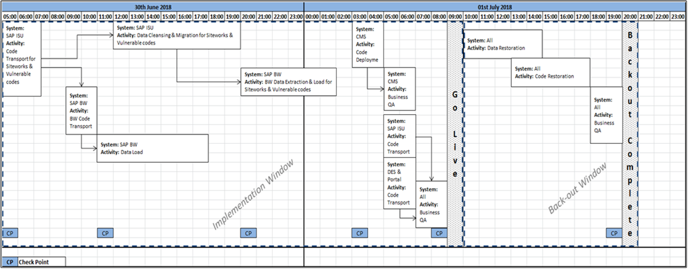
Option 1 - Xoserve Proposed High Level Cutover/Imp Plan

Slide 5
Option 1 File Formats – Input Files Transition Plan
As the implementation is on 30th June all files in the old file format will be processed by 11:59PM on 29th June 2018
Any files submitted from 30th June 00:00AM should be submitted in the new file format. These files will be held in AMT and processed only after the after implementation is completed on 01st July 2018
Any files received in the old file format (eg post the below date/times) after R2 implementation is complete on 01st July will be rejected
The detail of the file processing times will shared in the lower level cutover/implementation plan
Change ID | Last inbound in Old File Format
XRN4303 (UKLP267) | 29/06/2018 - SFN – 20:00PM
XRN3283 | 29/06/2018 - ACR – 17:00PM
XRN4449 (UKLP273) | 29/06/2018 - CNC – 18:00PM 29/06/2018 - CNF – 23:45PM

Slide 6
Option 1 File Formats – All impacted File Formats Transition Plan
Change ID | Last inbound in Old File Format | Last Outbound in Old File Format | First Inbound in New File Format | First outbound processed in New File format
XRN3477 (UKLP112) | NA | 29/06/2018 AES – 23:30PM | NA | 02/07/2018 AES – 23:30PM
XRN4303 (UKLP267) | 29/06/2018 SFN – 20:00PM | 29/06/2018 SFR will be processed as usual as there is no file format change | 30/06/2018 SFN – 20:00PM (Files will be held and processed on 01/07/18) | 01/07/2018 SFR will be processed as usual as there is no file format change
XRN3283 | 29/06/2018 ACR – 17:00PM | 29/06/2018 ARS will be processed as usual as there is no file format change | 02/07/2018 ACR – 8:00AM | 02/07/2018 ARS will be processed as usual as there is no file format change
XRN4449 (UKLP273) | 29/06/2018 CNC – 18:00PM CNF – 23:45PM | 29/06/2018 CNR and CFR will be processed depending on the batch job execution but will be completed by 23:59PM 30/06/2018 IDL – 10:00AM EDL – 06:00AM EWS – 06:00AM | 02/07/2018 CNC – 18:00PM CNF – 11:00AM | 02/07/2018 CFR – 12:15PM CNR – 18:00PM Refresh of Portfolio Files (EQL & EWS) – 17:00PM 01/07/18 IDL – 10:00AM EDL – 06:00AM EWS – 06:00AM
Note: This table aligns to Option 1 and based on the chosen option this may have to be revisited.
Full details will be defined in the lower level cutover/implementation plan

